Slide 1
Love Yourself
轉 Tear
themed PowerPoint template

Slide 2
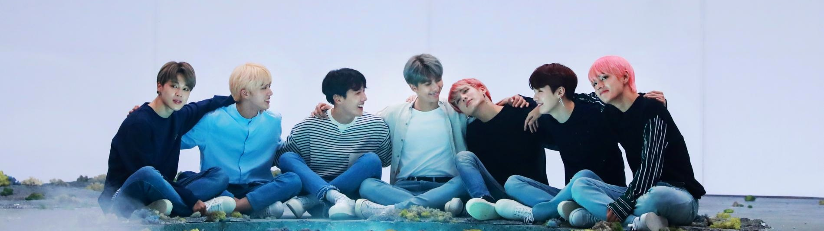

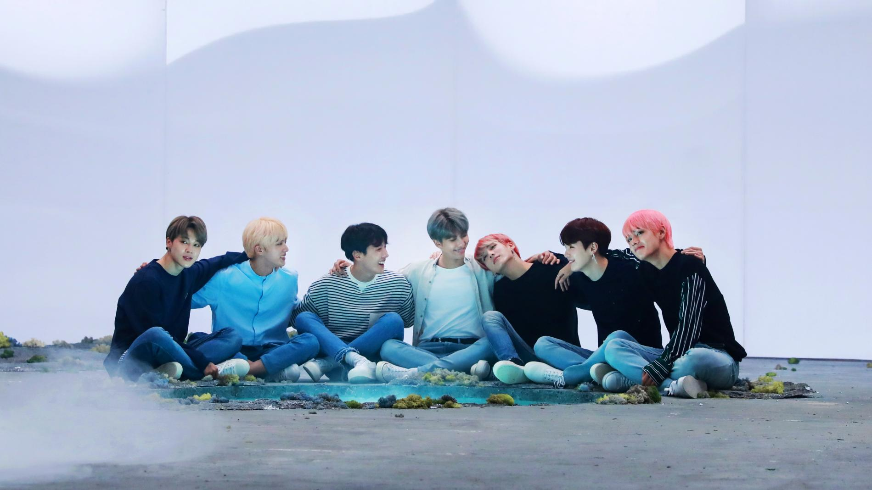
BTS joins hands with the United Nations Children’s Fund (UNICEF) to stage campaigns against violence toward children and teens around the world
with the hope of making the world a better place through music.

Slide 3
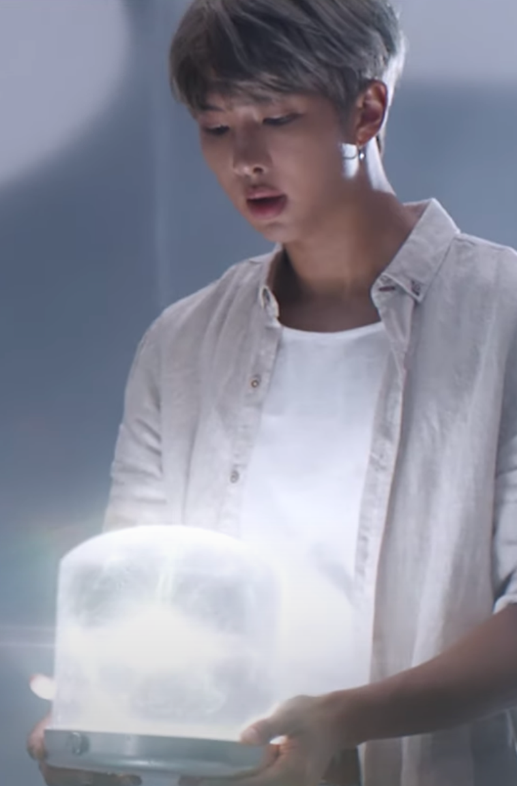
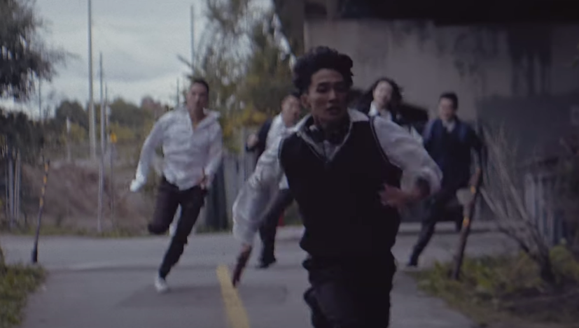
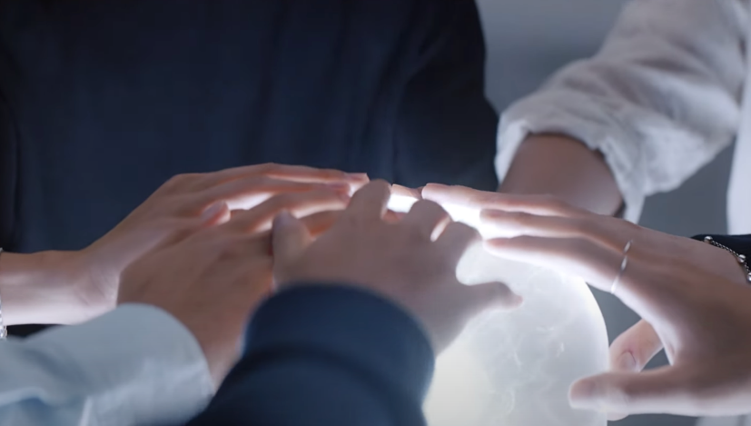
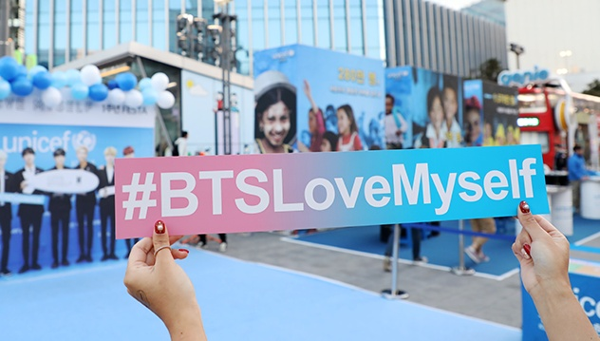
Challenge
Some children and teens are victims of violence.
Many are unable to enjoy their fair share of chances to dream of a safe and healthy future.
Solution
We want to lend a helping hand.
With our love and care, this world can be turned into a better place where people can dream of tomorrow.
Action
‘LOVE MYSELF’ and #ENDviolence.
We ask for your interest and participation in the LOVE MYSELF campaign, jointly staged by BTS and UNICEF.

Slide 4
The LOVE MYSELF campaign is delivering the true meaning of love globally
2017. 10. 16 ~ 31
2017. 11. 01
2018. 08. 25 ~ 26
2018. 09. 24
Teaser
Campaign launch
UNICEF booth
UN General Assembly Speech
Airship teaser for LOVE MYSELF campaign. “What I love” messages were flown over each BTS member’s hometown.
Big Hit Entertainment and BTS donated 500,000,000 KRW.
First UNICEF booth opened at the BTS tour venue at Seoul Olympic Stadium, which holds the highest official record for UNICEF’s single event.
(32,000 visitors, 70.9M KRW donations)
BTS spoke as the first Korean musical act at the 73rd UN General Assembly for Generation Unlimited.

Slide 5


A LOVE MYSELF fund is being raised over the next two years:
Donations worth 500M KRW from Big Hit Entertainment and the seven BTS members
Donations of 3% of the income from the sales of physical albums of the Love Yourself series
Donations of 100% of the income from the sales of official goods for the LOVE MYSELF campaign
Donations at the donation desks installed by UNICEF
LINE Donation Sticker
Kakao Give-ticon

Slide 6


Love yourself
承 Her

